Slide 1

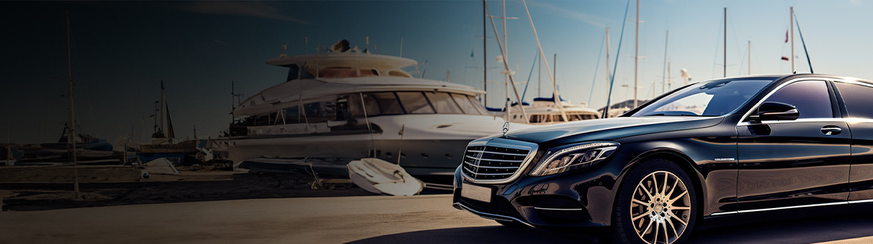

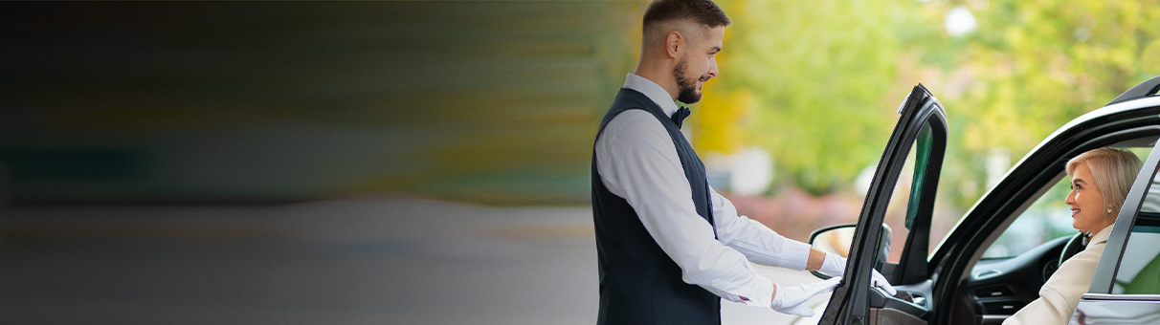
Luxury Chauffeur Service Sydney

Slide 2
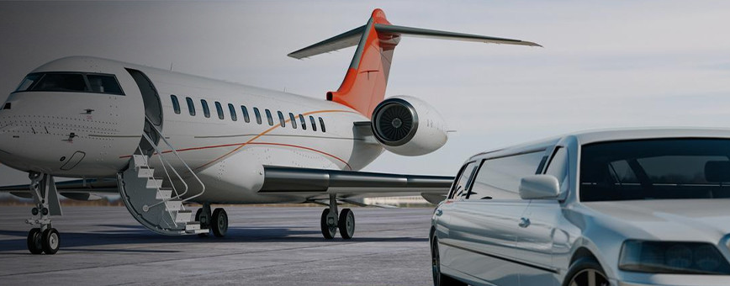
Luxury Chauffeur Service Sydney by Chauffeur Hire delivers an unmatched travel experience, blending sophistication and comfort. Their fleet of premium vehicles and professional chauffeurs cater to corporate events, special occasions, and airport transfers. With a commitment to punctuality and personalized service, they ensure every journey is seamless and stress-free. Experience Sydney in style and elegance with their reliable and luxurious transportation solutions.
Visit - https://www.chauffeurhire.com.au/

Slide 3



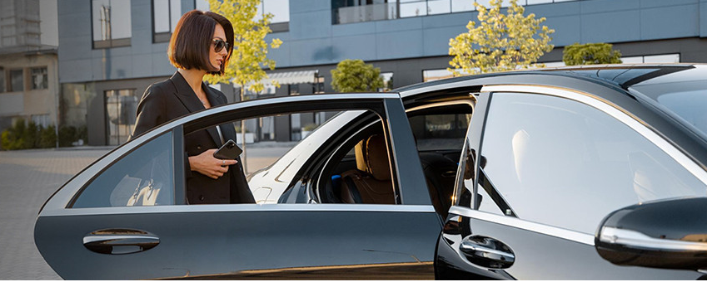



THANK YOU
12 Brahman Rd, Box Hill NSW 2765
+61 451139131

