Slide 1



Cruise Terminal Transfer Services Sydney

Slide 2

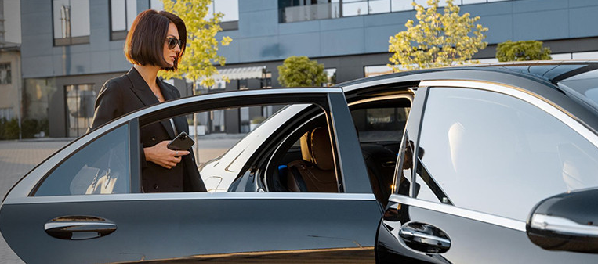
Chauffeur Hire offers seamless and luxurious cruise terminal transfers in Sydney, ensuring stress-free and stylish transportation to your destination. Their professional chauffeurs provide timely service, assisting with luggage and offering personalized experiences tailored to individual traveler needs. With a premium fleet of vehicles, they guarantee comfort and elegance throughout your journey.

Slide 3





THANK YOU
Address - 12 Brahman Rd, Box Hill NSW 2765
Call - +61 451139131
Visit - https://www.chauffeurhire.com.au/our-services/cruise-terminal-transfer-in-sydney

