Slide 1
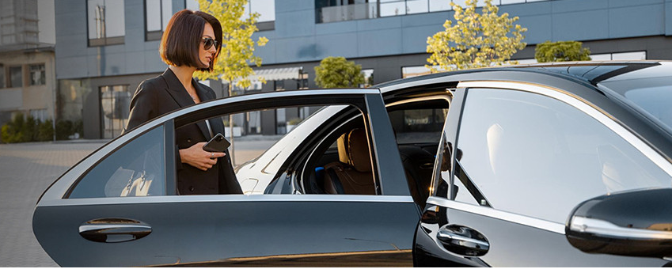


Corporate Transfer Service Sydney

Slide 2

Chauffeur Hire offers premium corporate transfers in Sydney, ensuring punctual, professional, and luxurious transportation. With experienced chauffeurs and high-end vehicles, they provide seamless, stress-free travel for business executives and corporate clients.

Slide 3




THANK YOU
Address - 12 Brahman Rd, Box Hill NSW 2765
Call - +61 451139131
Visit - https://www.chauffeurhire.com.au/our-services/corporate-transfer-in-sydney

