Slide 1

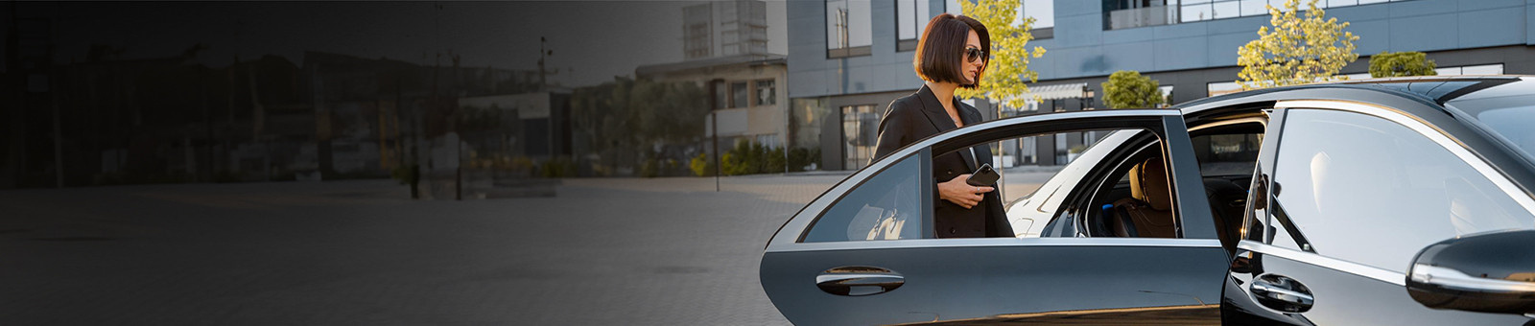
Luxury Hotel Transfers Sydney
By Chauffeur Hire

Slide 2

Chauffeur Hire offers premium hotel transfer services in Sydney, providing luxury vehicles, punctual chauffeurs, and tailored experiences for a smooth, stress-free journey.

Slide 3

Address - 12 Brahman Rd, Box Hill NSW 2765
Call - +61 451139131
Visit - https://www.chauffeurhire.com.au/our-services/hotel-transfer-in-sydney

Slide 4

Thank You
For more details, visit - https://www.chauffeurhire.com.au/our-services/hotel-transfer-in-sydney

