Slide 1
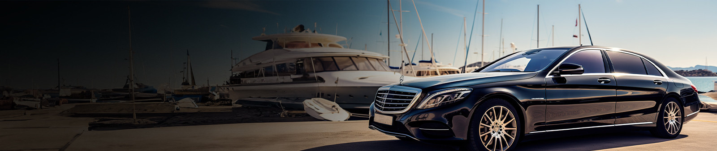


Cruise Terminal Transfers Sydney

Slide 2

Chauffeur Hire offers luxury cruise terminal transfers in Sydney, ensuring a seamless and comfortable journey.
  Effortless arrivals and departures.
  Punctual, reliable chauffeur services.
  High-end, well-maintained vehicles.
  Personalized travel experiences offered.
  Easy online booking process.
Key Featurers

Slide 3



THANK YOU
Address - 12 Brahman Rd, Box Hill NSW 2765
Call - +61 451139131
Visit - https://www.chauffeurhire.com.au/our-services/cruise-terminal-transfer-in-sydney

