Slide 1
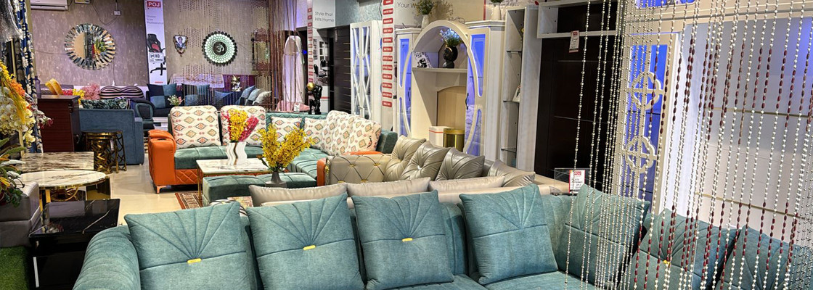

Buy Living Room Furniture Online

Slide 2
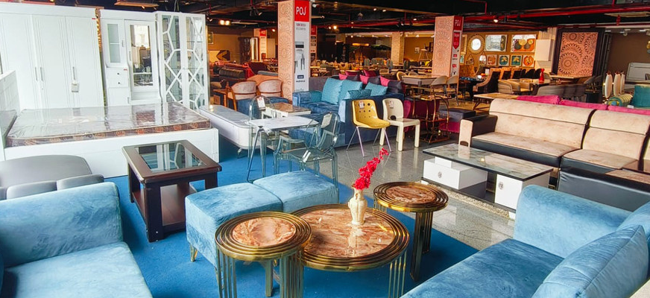

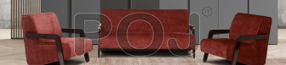
POJ Furniture showcases premium home and office furniture, offering stylish and functional designs. As a leading wooden furniture store, it provides quality solutions for diverse customer needs.

Slide 3
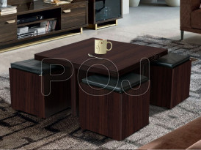
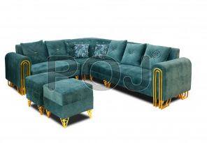

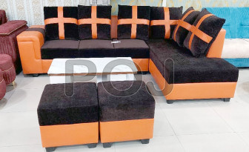

Visit - https://www.pojfurniture.com/products/living-room-furniture

