Slide 1

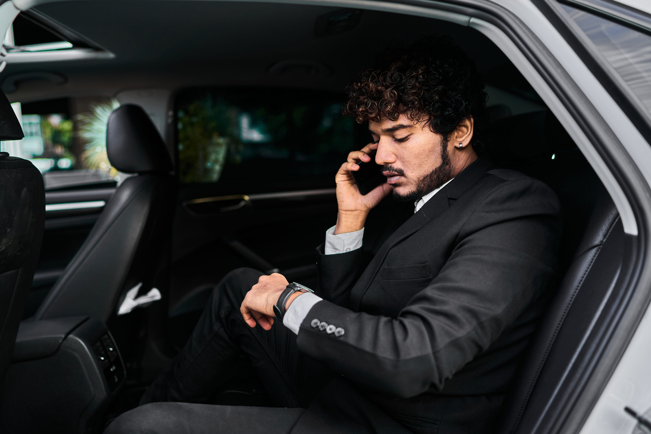
Airport Chauffeur Services Sydney
Travel in comfort and style with professional Airport Chauffeur Services Sydney by Chauffeur Hire. We provide premium airport transportation for business travelers, tourists, families, and corporate clients across Sydney.
Key Highlights
  Luxury and clean chauffeur vehicles
  Professional and experienced drivers
  On-time airport pickup and drop-off
  Comfortable and stress-free travel
  Available for corporate and personal trips
https://www.chauffeurhire.com.au/our-services/corporate-transfer-in-sydney

Slide 2

Reliable Airport Transfers
Our Airport Chauffeur Services Sydney are designed to make your journey smooth and relaxing. We monitor flight schedules and ensure timely arrivals for every client.
Why Choose Chauffeur Hire?
  Flight tracking for timely pickup
  Meet and greet service at the airport
  Assistance with luggage
  Safe and private transportation
  24/7 customer support

Slide 3
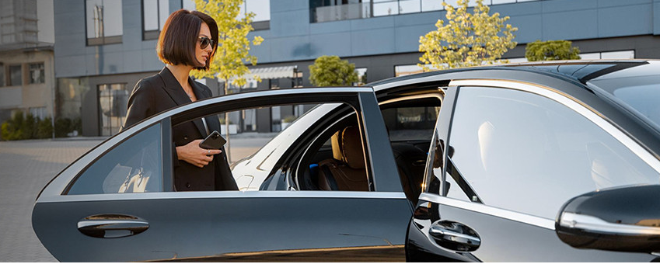
Luxury Travel Experience
With Chauffeur Hire, passengers enjoy premium travel experiences in luxury vehicles. Whether you are traveling for business or holidays, our chauffeurs deliver first-class service every time.
Our Services Include
  Airport transfers
  Corporate travel
  Hotel transfers
  VIP transportation
  Family and group travel

Slide 4

Book Your Airport Chauffeur Today
Choose Chauffeur Hire for reliable, stylish, and professional airport transportation in Sydney. We focus on comfort, punctuality, and customer satisfaction.
Benefits of Our Chauffeur Service
  Luxury vehicles for every journey
  Experienced and courteous chauffeurs
  Easy booking process
  Affordable premium service
  Comfortable travel across Sydney

Slide 5
THANK YOU
BOOK YOUR SYDNEY CHAUFFEURS TODAY
Experience premium travel with Sydney Chauffeurs. We are ready to serve you 24/7 with reliable and luxurious transport solutions.
Address:
12 Brahman Rd, Box Hill NSW 2765
Call:
+61 1300210378
Book Online:
https://www.chauffeurhire.com.au/our-services/corporate-transfer-in-sydney

