Slide 1


Sydney Chauffeurs
Experience premium travel with professional Sydney Chauffeurs by Chauffeur Hire. We provide luxury transportation services for airport transfers, business travel, events, and private journeys across Sydney.
Our Premium Services
  Luxury chauffeur-driven vehicles
  Airport pickup and drop-off
  Corporate travel solutions
  Wedding and event transfers
  Comfortable private transportation
https://www.chauffeurhire.com.au/

Slide 2

Travel with Comfort and Confidence
At Chauffeur Hire, we focus on providing reliable and stress-free travel experiences. Our professional chauffeurs ensure every journey is smooth, safe, and on time.
Why Choose Sydney Chauffeurs?
  Experienced and licensed chauffeurs
  Luxury and clean vehicles
  Punctual and professional service
  24/7 booking availability
  Personalized customer support

Slide 3

Premium Transportation for Every Occasion
Whether you are traveling for business or leisure, our Sydney Chauffeurs service offers style, privacy, and convenience for every trip.
Perfect For
  Corporate meetings
  Airport transfers
  Hotel transportation
  VIP and executive travel
  Family and private tours

Slide 4
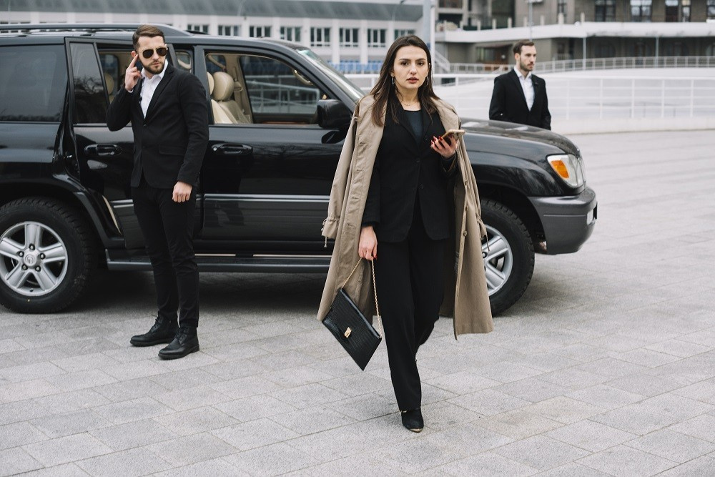
Premium Chauffeur Travel Across Sydney
Choose Chauffeur Hire for luxury and professional chauffeur services in Sydney. We are committed to delivering safe, comfortable, and first-class travel experiences.
Benefits of Our Chauffeur Services
  Comfortable luxury vehicles
  Professional customer service
  Safe and smooth journeys
  Affordable luxury travel
  Easy online booking process

Slide 5
THANK YOU
BOOK YOUR SYDNEY CHAUFFEURS TODAY
Experience premium travel with Sydney Chauffeurs. We are ready to serve you 24/7 with reliable and luxurious transport solutions.
Address:
12 Brahman Rd, Box Hill NSW 2765
Call:
+61 1300210378
Book Online:
https://www.chauffeurhire.com.au/

