Slide 1

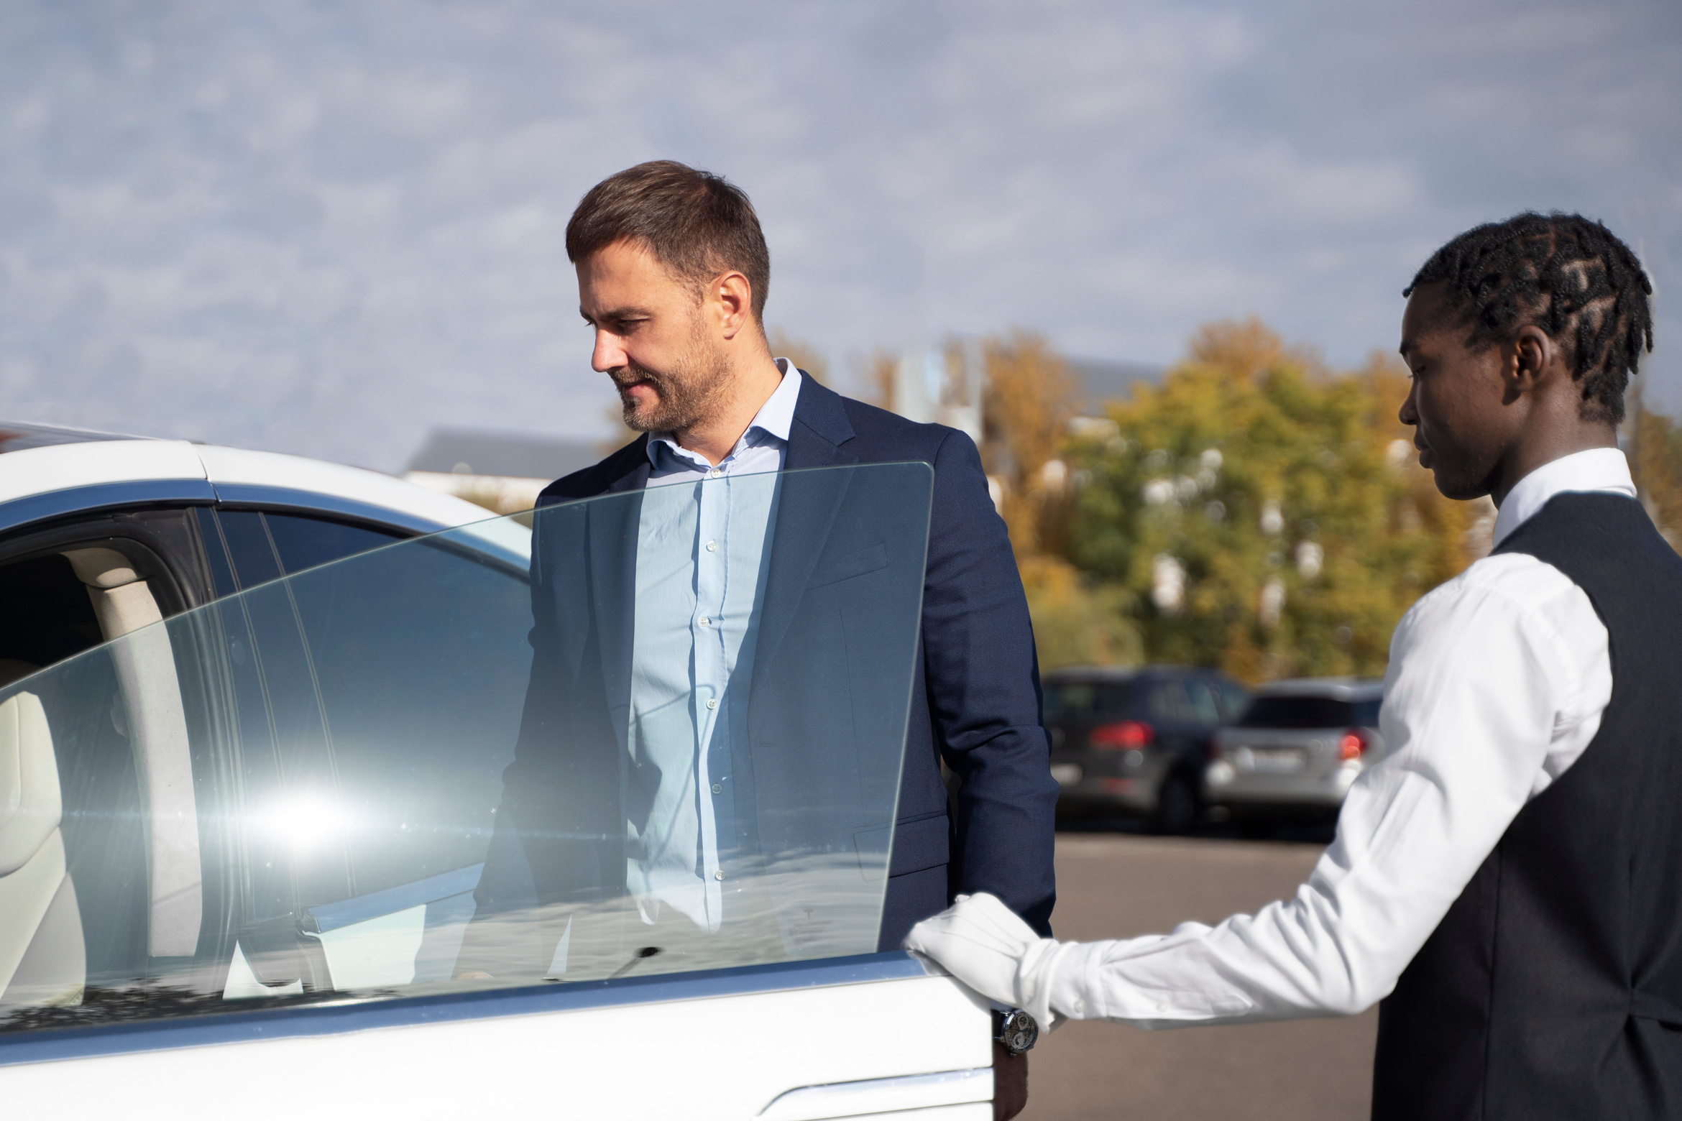
Blue Mountain Airport Transfer
Looking for a reliable Blue Mountain Airport Transfer service? Chauffeurs Link offers luxury airport transfers with professional chauffeurs, clean vehicles, and on-time pickups. Whether you are travelling for business, holidays, or family trips, we make every journey smooth and stress-free.
Key Highlights:
  Luxury and comfortable vehicles
  Professional and experienced chauffeurs
  On-time airport pickups and drop-offs
  Safe and smooth travel experience
  24/7 booking availability
https://www.chauffeurhire.com.au/our-services/blue-mountain-chauffeur-service

Slide 2
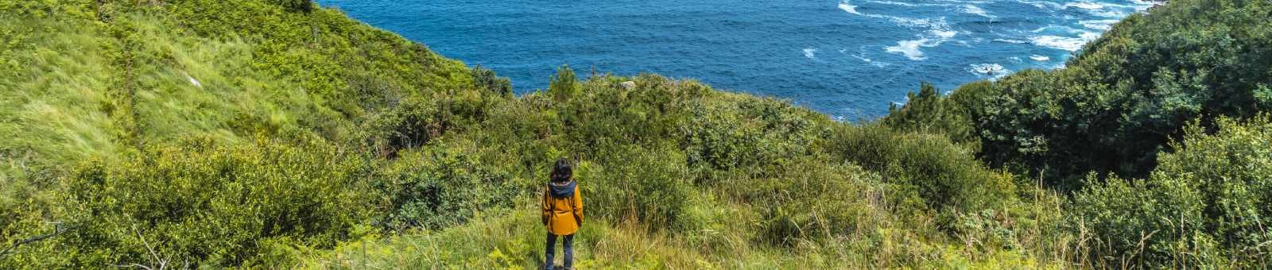
Easy & Hassle-Free Airport Transfers
Avoid taxi delays and crowded transport with our premium Blue Mountain Airport Transfer service. Chauffeurs Link provides direct airport transportation with modern vehicles designed for comfort and convenience.
Why Choose Us?
  Flight tracking for timely pickups
  Meet and greet service at airport
  Spacious cars for luggage and families
  Easy online booking process
  Affordable luxury travel solutions

Slide 3
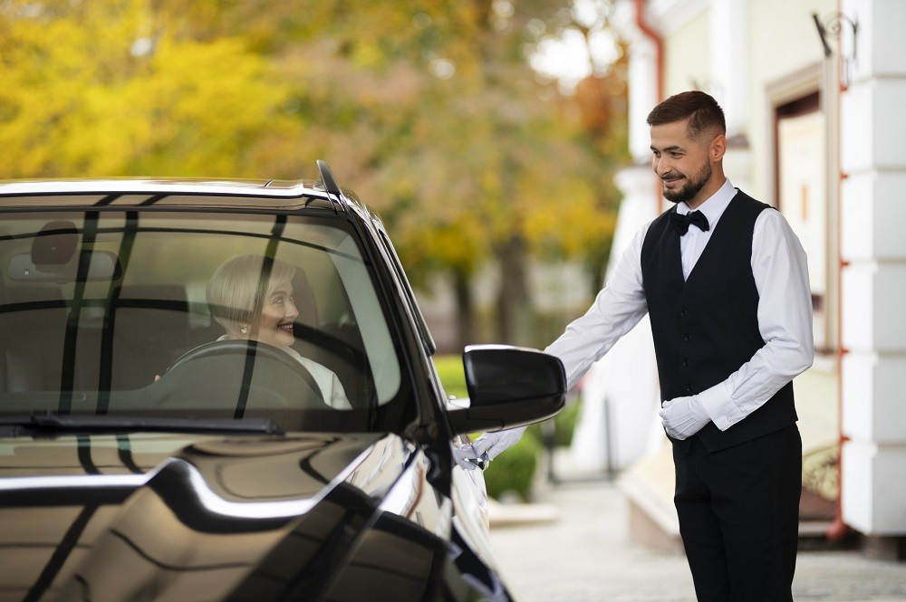
Trending Luxury Travel Experience
Luxury travel is becoming a top trend in Sydney and the Blue Mountains. Travelers now prefer private chauffeur services for better comfort, privacy, and safety. Chauffeurs Link delivers a premium Blue Mountain Airport Transfer experience for tourists, corporate travelers, and families.
Trending Benefits:
  Private and peaceful travel
  Premium executive vehicles
  Safe travel for families and tourists
  Comfortable long-distance rides
  Perfect for business and holiday trips

Slide 4
Book Your Blue Mountain Airport Transfer Today
Choose Chauffeurs Link for dependable and professional Blue Mountain Airport Transfer services. We focus on customer comfort, punctuality, and luxury travel experiences across Sydney and Blue Mountains.
Our Services Include:
  Airport Transfers
  Corporate Transfers
  Luxury Chauffeur Services
  Hotel Transfers
  Event & Business Travel

Slide 5
THANK YOU
BOOK YOUR SYDNEY CHAUFFEURS TODAY
Experience safe, stylish, and reliable airport transfers with professional chauffeurs.
Address:
12 Brahman Rd, Box Hill NSW 2765
Call:
+61 1300210378
Book Online:
https://www.chauffeurhire.com.au/our-services/blue-mountain-chauffeur-service

