Slide 1


Luxury Corporate Transfers Sydney
Professional Travel for Modern Businesses
Chauffeur Hire offers premium Luxury Corporate Transfers Sydney services for executives, business professionals, and corporate teams. Our service combines luxury, comfort, and reliability to ensure every business journey is smooth and stress-free.
  Executive-class vehicles
  Professional chauffeurs
  Timely pickups and drop-offs
  Comfortable and productive travel experience
https://www.chauffeurhire.com.au/our-services/corporate-transfer-in-sydney

Slide 2
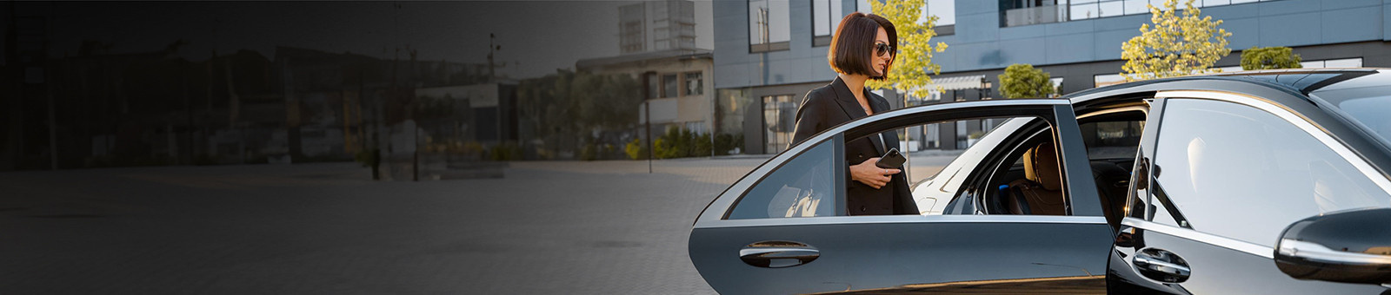
Why Businesses Choose Chauffeur Hire
In today’s fast-paced business environment, reliable transportation is essential. Our Luxury Corporate Transfers Sydney service helps professionals travel efficiently while maintaining a high standard of comfort and professionalism.
Key Benefits:
  Punctual and dependable service
  Luxury fleet for executive travel
  Privacy for calls and meetings on the move
  Flexible booking options
  Professional and experienced chauffeurs
We help businesses make a strong impression from the moment the journey begins.

Slide 3

Corporate Travel Solutions Tailored to Your Needs
At Chauffeur Hire, we understand that every business has unique transportation requirements. Our Luxury Corporate Transfers Sydney service is designed to support a variety of corporate travel needs.
Ideal For:
  Business meetings
  Corporate events
  Airport transfers
  Client transportation
  Executive roadshows
  Conference and seminar travel
Our focus is on delivering comfort, efficiency, and a premium travel experience every time.

Slide 4
THANK YOU
Elevate Your Business Travel with Chauffeur Hire Today!
Address:
12 Brahman Rd, Box Hill NSW 2765
Call:
+61 1300210378
Book Online:
https://www.chauffeurhire.com.au/our-services/corporate-transfer-in-sydney

