Slide 1

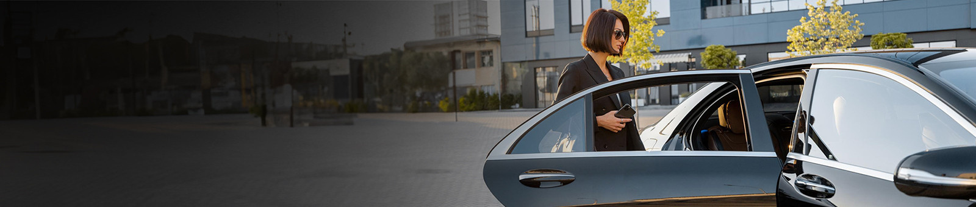
Corporate Transfer Service Sydney
Corporate travel requires reliability, comfort, and professionalism. Chauffeur Hire provides premium Corporate Transfer Service Sydney for executives, business teams, and corporate clients. Our luxury vehicles and experienced chauffeurs ensure every journey is smooth, comfortable, and punctual.
Key Benefits:
• Professional Chauffeurs
• Luxury Executive Vehicles
• On-Time Pickups
• Stress-Free Business Travel
• Sydney-Wide Coverage
https://www.chauffeurhire.com.au/our-services/corporate-transfer-in-sydney

Slide 2

Business Travel Made Easy
At Chauffeur Hire, we understand the importance of making a great impression. Our Corporate Transfer Service Sydney is designed to help professionals travel efficiently between airports, offices, hotels, meetings, and corporate events.
Our Services Include:
• Airport Corporate Transfers
• Executive Meeting Transport
• Conference and Event Transfers
• VIP Client Transportation
• Multi-Destination Business Travel
Travel comfortably while staying focused on your business priorities.

Slide 3

Why Choose Chauffeur Hire?
Chauffeur Hire delivers a premium transportation experience tailored to corporate needs. We combine luxury, professionalism, and reliability to ensure your business travel runs smoothly every time.
Why Businesses Trust Us:
✔ Professional Service
✔ Modern Luxury Fleet
✔ Flexible Booking Options
✔ Competitive Pricing
✔ Safe and Reliable Travel
Chauffeur Hire – Your Trusted Partner for Corporate Transfer Service Sydney.

Slide 4
THANK YOU
Elevate Your Business Travel with Chauffeur Hire Today!
Address:
12 Brahman Rd, Box Hill NSW 2765
Call:
+61 1300210378
Book Online:
https://www.chauffeurhire.com.au/our-services/corporate-transfer-in-sydney

