Slide 1



SYDNEY AIRPORT CHAUFFEUR SERVICES
CHAUFFEUR HIRE
HTTPS://WWW.CHAUFFEURHIRE.COM.AU/OUR-SERVICES/AIRPORT-TRANSFER-IN-SYDNEY

Slide 2
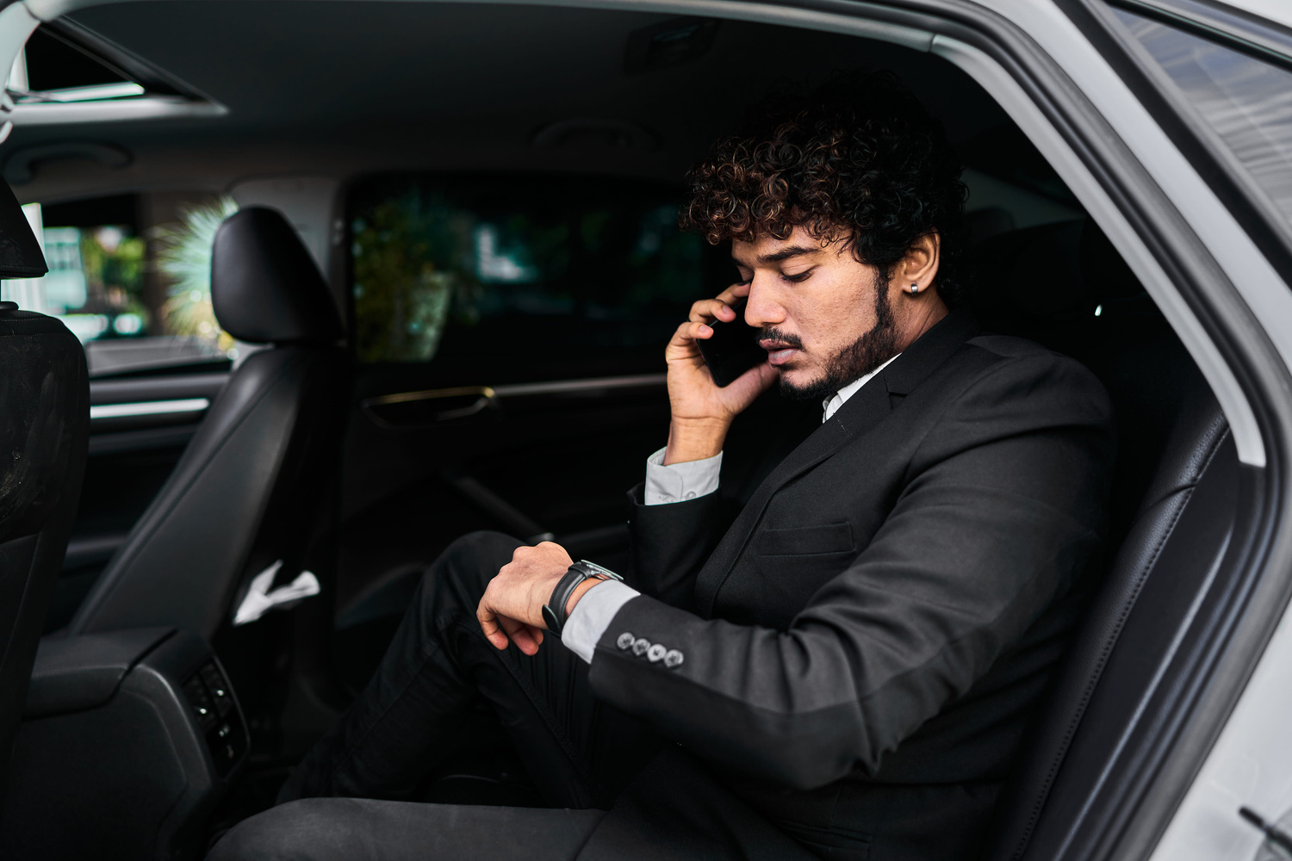
Travel to and from the airport with comfort and confidence. Chauffeur Hire provides premium Sydney Airport Chauffeur Services for business and leisure travellers. Our professional chauffeurs ensure every journey is safe, comfortable, and on time.
SYDNEY AIRPORT CHAUFFEUR SERVICES BY CHAUFFEUR HIRE

Slide 3

WHY CHOOSE OUR SYDNEY AIRPORT CHAUFFEUR SERVICES?
  Professional and experienced chauffeurs
  Always on-time airport pickups and drop-offs
  Luxury vehicles that are clean and comfortable
  Flight tracking for timely arrivals
  Available for individuals, families, and business travellers
With Chauffeur Hire, every airport transfer is smooth and stress-free.

Slide 4

OUR AIRPORT TRANSFER SERVICES
Our Sydney Airport Chauffeur Services include:
  Airport pickups and departures
  Corporate airport transfers
  Hotel and airport transfers
  Family and group travel
  VIP and executive airport transportation
We make every journey comfortable from the moment you book until you reach your destination.

Slide 5
BOOK WITH CHAUFFEUR HIRE
Choose Chauffeur Hire for trusted Sydney Airport Chauffeur Services that combine luxury, reliability, and professional service.
Why Clients Trust Us
  Luxury Fleet
  Professional Chauffeurs
  On-Time Service
  24/7 Availability
  Easy Online Booking
Chauffeur Hire – Your Reliable Partner for Sydney Airport Chauffeur Services.

Slide 6

CONTACT US
Address - 12 Brahman Rd, Box Hill NSW 2765
Call - +61 1300210378
HTTPS://WWW.CHAUFFEURHIRE.COM.AU/OUR-SERVICES/AIRPORT-TRANSFER-IN-SYDNEY

