Slide 1



SYDNEY CRUISE TERMINAL TRANSFERS
CHAUFFEUR HIRE
HTTPS://WWW.CHAUFFEURHIRE.COM.AU/OUR-SERVICES/CRUISE-TERMINAL-TRANSFER-IN-SYDNEY

Slide 2

Start or finish your cruise with comfort and peace of mind. Chauffeur Hire offers professional Sydney Cruise Terminal Transfers with luxury vehicles and experienced chauffeurs. We provide safe, reliable, and punctual transportation to and from Sydney's cruise terminals.
RELIABLE SYDNEY CRUISE TERMINAL TRANSFERS BY CHAUFFEUR HIRE

Slide 3

WHY CHOOSE CHAUFFEUR HIRE?
Benefits of Our Sydney Cruise Terminal Transfers
  Professional and courteous chauffeurs
  Luxury, clean, and comfortable vehicles
  On-time pickups and drop-offs
  Assistance with luggage
  Suitable for individuals, families, and groups
  Easy and secure booking process
Travel without stress and enjoy a smooth transfer every time.

Slide 4
OUR TRANSFER SERVICES
WHAT WE OFFER
Our Sydney Cruise Terminal Transfers include:
  Cruise terminal pickups
  Cruise departure transfers
  Hotel to cruise terminal transfers
  Airport to cruise terminal transfers
  Private and corporate transportation
  Door-to-door luxury travel
We make every journey comfortable, safe, and convenient.

Slide 5
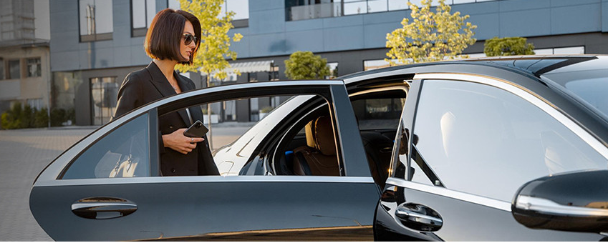
BOOK YOUR TRANSFER TODAY
TRAVEL WITH CONFIDENCE
Choose Chauffeur Hire for premium Sydney Cruise Terminal Transfers and enjoy professional service from start to finish.
Why Customers Trust Us
  Luxury Fleet
  Experienced Chauffeurs
  Reliable Service
  24/7 Availability
  Comfortable Travel
Chauffeur Hire – Your Trusted Choice for Sydney Cruise Terminal Transfers.

Slide 6

CONTACT US
Address - 12 Brahman Rd, Box Hill NSW 2765
Call - +61 1300210378
HTTPS://WWW.CHAUFFEURHIRE.COM.AU/OUR-SERVICES/CRUISE-TERMINAL-TRANSFER-IN-SYDNEY

