Slide 1


Chauffeur Services Sydney
Travel in Comfort and Style
Chauffeur Hire provides reliable Chauffeur Services Sydney for business and personal travel. We offer luxury vehicles driven by professional chauffeurs who focus on safety, comfort, and punctuality. Whether you need airport transfers, corporate travel, hotel transfers, or special event transportation, we make every journey smooth and stress-free.
https://www.chauffeurhire.com.au/

Slide 2

Why Choose Chauffeur Hire?
Professional Service You Can Trust
  Professional and experienced chauffeurs
  Luxury, clean, and comfortable vehicles
  On-time pickups and dependable service
  Airport, corporate, hotel, and event transfers
  Safe, private, and hassle-free travel
  Available for individuals, families, and business travellers
With Chauffeur Hire, our Chauffeur Services Sydney are designed to provide a premium travel experience for every customer.

Slide 3
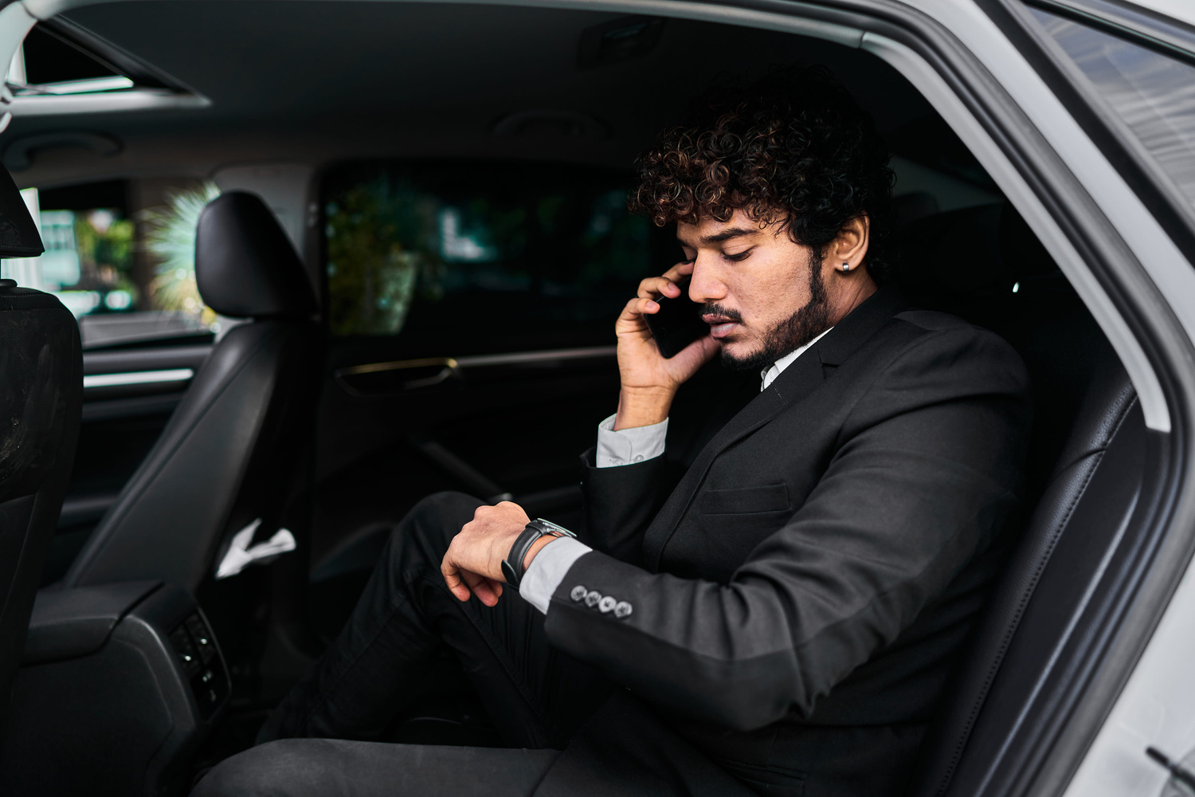
Book Chauffeur Services Sydney
Experience Premium Travel
Choose Chauffeur Hire for trusted Chauffeur Services Sydney that deliver comfort, reliability, and excellent customer service. From short city trips to full-day bookings, our professional chauffeurs ensure every ride is comfortable, punctual, and enjoyable.

Slide 4
THANK YOU
Address:
12 Brahman Rd, Box Hill NSW 2765
Call:
+61 1300210378
Book Online:
https://www.chauffeurhire.com.au/

